Slide 1

Drugs Review
G2T5
Jose Tan
Neo Jia Ying
Nor Aisyah
Wong Wei Ling

Slide 2


TABLE OF CONTENTS
01
04
INTRODUCTION
EDA
02
05
LIT REVIEW
METHODOLOGY & RESULTS
03
06
DATASET, TOOLS & RESOURCES
FUTURE WORK

Slide 3


01
Introduction
Project Title
Problem Statement
Motivation

Slide 4
Project Title
Discovering insights from patient’s reviews and recommend most suitable drug using Regression and Classification models
Notes:
Project title

Slide 5

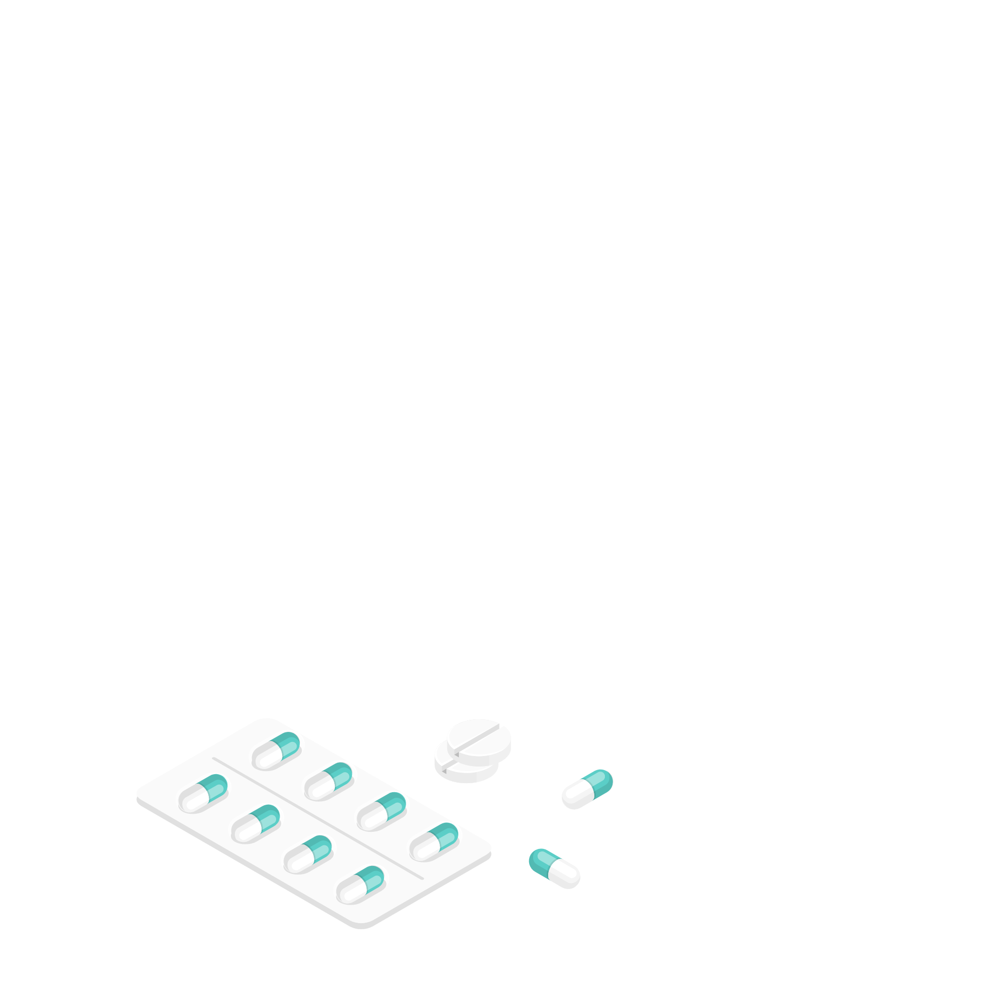
Description
Drug reviews play a significant role in providing crucial medical care information
Patients now are more health conscious
Increasingly using the Internet to gather information in managing their own health
Looking for stories from patients online, which they might not be able to find among their friends and family.

Slide 6
Problem
An overwhelming number of over-the-counter drug reviews online.
Patients have to go through them manually and individually to find the most suitable drug for their condition
Highly inefficient and time consuming

Slide 7
Motivation
Aid patients in self prescription of drugs
Gather insights on patient’s reviews & recommend the top drugs based on other patients’ reviews, ratings and sentiment scores
Improve the effectiveness of the review sites and efficiency in the time taken to find the best drug.

Slide 8

02
Literature Review

Slide 9
Research Paper 1
Disease Prediction and Drug Recommendation Android Application using Data Mining (Virtual Doctor)
Predict disease by analyzing user's symptoms using machine learning algorithms (Decision Tree, Naive Bayes, KNN etc.)
Recommend drugs using weighted average method (Useful count + Rating)
Top 5 rated drugs will be recommended for each disease in the Android Application

Slide 10
Improvements
Find out sentiment score of drug reviews
Predict rating of each review for test data with regression models (sentiment score, useful count,rating of train data).
Strengthen reliability
People who have taken the drug and find that it is good will review it positively

Slide 11
Research Paper 2
Detecting Side Effects and Evaluating Effectiveness of Drugs from Customers’ Online Reviews using Text Analytics and Data Mining Models
Classified reviews into meaningful attributes to provide helpful recommendation to users in selecting best drug (Neural Network, Logistic Regression etc)
Considers the side effects of a drug
Determine if the benefits can outweigh the side effects
Compare with similar drugs

Slide 12
Improvements
All rounded approach instead of just looking at side effects
Take into account:
Rating of drug
Useful count of review
Sentiment score for review
Number of users who rated the drug
Derive an overall score for each drug and recommend to users based on 4 factors.

Slide 13

03
Dataset

Slide 14
Dataset
ID
(Numerical)
drugName
(Categorical)
condition
(Categorical)
review
(Text)
rating
(Numerical)
date
(Interval)
usefulCount
(Numerical)
Index of review entry (Column is renamed during data cleaning)
Name of drug
Name of medical condition
Patients’ review
10 star patient rating
Date of review entry
Number of users that found review useful
Notes:
7 attributes

Slide 15
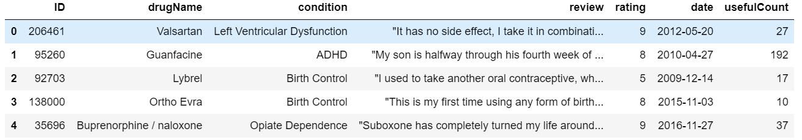
Dataset
2 datasets downloaded from UCI Machine Learning Repository (Train & Test)
Proportion of test data to train data is approximately 33.33%

Slide 16

04
EDA

Slide 17
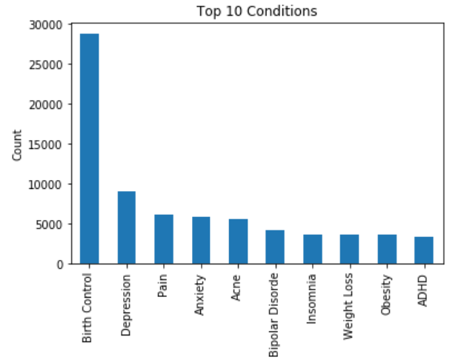
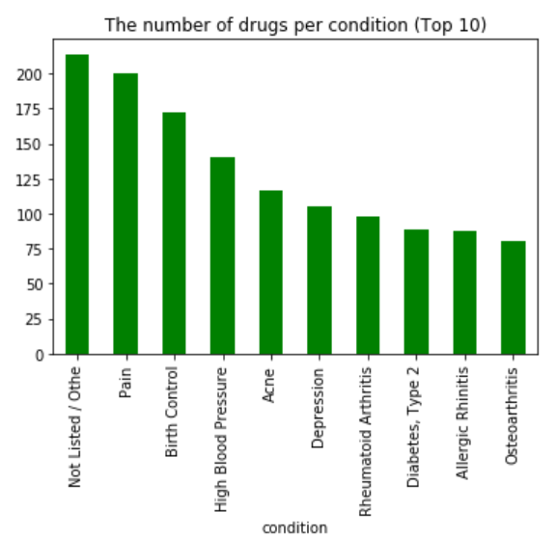
EDA

Slide 18
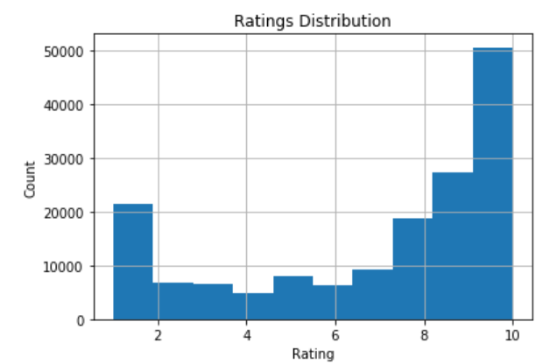
Skewed ‘ratings’ distribution

Slide 19
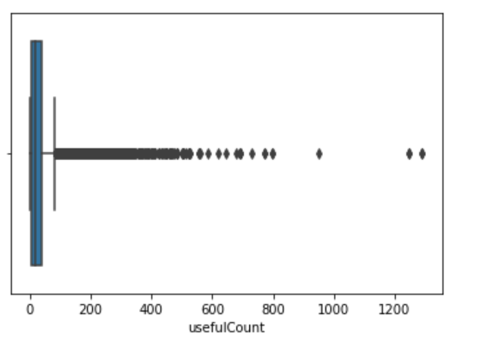
Presence of Outliers

Slide 20
Preliminary Selection of Tool
Predicting Sentiment Score of Review with Vader and TextBlob
Sentiment | Vader | Textblob
Positive | Score >= 0.05 | Score > 0
Neutral | -0.05 < Score < 0.05 | Score = 0
Negative | Score <= -0.05 | Score < 0
Notes:
To predict the sentiment score of the reviews, we performed sentiment analysis using Vader (Compound) and Textblob (Polarity).
The following table shows how Vader and TextBlob classify a sentiment as positive, neutral or negative.

Slide 21
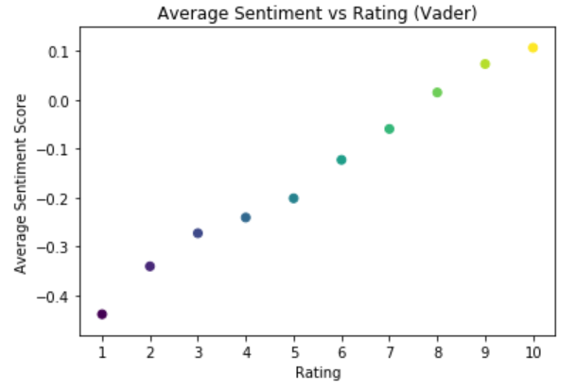
Vader
Neutral sentiment: ratings 7 & 8
Positive sentiment: ratings 9 & 10
Negative sentiment: ratings < 7
Notes:
Based on how Vader classifies a sentiment as positive, neutral and negative, it can be observed that rating 7 and 8 has neutral sentiment, rating 9 and 10 has positive sentiment and rating < 7 has negative sentiment.

Slide 22
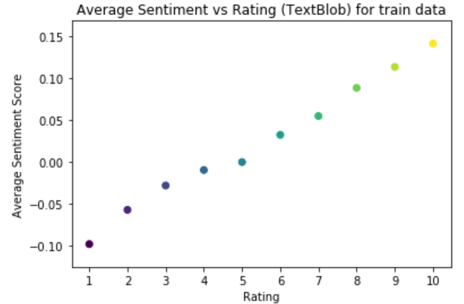
TextBlob
Neutral sentiment: rating 5
Positive sentiment: ratings >= 6
Negative sentiment: ratings < 5
Notes:
Based on how TextBlob classifies a sentiment as positive, neutral and negative, it can be observed that rating 5 has neutral sentiment, rating>= 6 has positive sentiment and rating < 5 has negative sentiment.

Slide 23
Vader or TextBlob?
Vader work better with slang, emojis, etc.
TextBlob performs better with more formal language usage
Since our reviews are written in more formal language, TextBlob will be better.
Notes:
From our research, Vader seems to work better with slang, emojis, etc. whereas TextBlob performs better with more formal language usage. Hence, we feel that Vader is not performing well for this dataset since our reviews are written in more formal language.

Slide 24

05
Methodology & Results

Slide 25
Objectives
Predict Sentiment Score of Review and Classify the Reviews based on Sentiment
Predict Ratings of each review on Test Data
Determine Overall Score of Each Drug to Recommend to Patients

Slide 26
05a.
Predict Sentiment Score of Review and Classify the Reviews Based on Sentiment

Slide 27
Predict Sentiment Score of Review and Classify the Reviews Based on Sentiment
From our preliminary results, we used TextBlob to predict sentiment scores.
Used Term Frequency - Inverse Document Frequency (TF-IDF method) to convert the raw text into numerical format so that it can be processed by classifiers.
6 Classification models used: Logistic Regression, Naive Bayes, Random Forest, Decision Tree, KNN and Adaboost
Notes:
This can be achieved using the TF-IDF method. TF-IDF evaluates how relevant a word is to a document in a collection of documents by multiplying two metrics: the number of times a word appears in a document and the inverse document frequency of the word across a dataset (Stecanella, 2019).
Classification models.

Slide 28
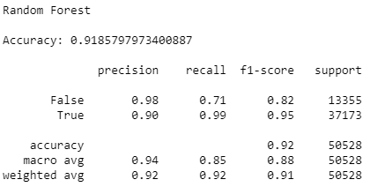
Predict Sentiment Score of Review and Classify the Reviews Based on Sentiment
Results
Used macro average F1-score to determine the best performing model as our data is imbalanced (13355 vs 37173)
Random Forest has the highest macro average F1 score, thus it is our best performing model
Notes:
Since the data is imbalance (13355 vs 37173), we cannot use accuracy to determine which model performed the best. Instead, we should use the macro avg of F1 score.
Random Forest has the highest macro avg for F1 score, 88%. Hence, Random Forest is the best performing model out of the 6 sentiment classifier models.

Slide 29
05b.
Predict Ratings of each review on Test Data

Slide 30
Predict Ratings of Each Review on Test Data
Used rating of drug, useful count & sentiment score of reviews to train regression models
Scaling is done because useful count and sentiment scores are on different scales
Used RobustScaler as outliers are present in our dataset
5 Regression models used: KNN, Multiple Linear Regression, Decision Tree, Lasso, Ridge and ElasticNet Regression
Notes:
Robust Scaler: doesn't take the median into account and only focuses on the parts where the bulk data is

Slide 31
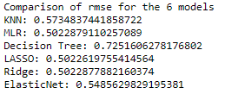
Predict Ratings of Each Review on Test Data
Results
Used RMSE as:
It is a good measure for how accurately a model predicts the response
Accuracy is the most important criterion for fit if the model is used for prediction
Notes:
Adjusted r square is to see whether the variables can explain your model but rmse is how well your model can predict values

Slide 32
05c.
Determine Overall Score of Each Drug to Recommend to Patients

Slide 33
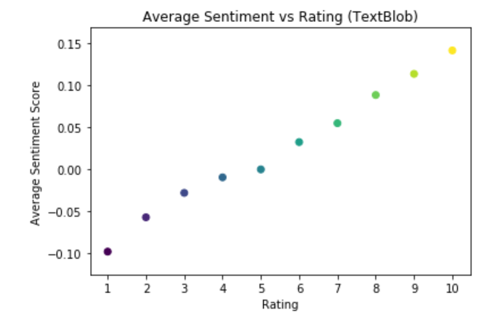
Determine Overall Score of Each Drug to Recommend to Patients
Initially we wanted to determine overall score of drug with:
Rating of drug
Useful count of review
Sentiment score for review
Number of users who rated the drug
However, sentiment score is omitted as it is correlated to rating
Notes:
As our dataset has outliers, we used the median rating of drug, median useful counts of reviews, and number of users who rated the drug to predict the overall score of each drug. We omitted the median sentiment score for each review because the sentiment score is correlated with rating based on our Exploratory Data Analysis.
The equation that we used to determine the overall score of drugs is as follows:
score = x%*(Median usefulCount) + y%*(Number of users who rated the drug) + z%*(Median rating of drug)
The x, y, z are determined using feature importance and this is done using ExtraTrees Classifier. Unlike Random Forest, Extra Trees do not select an optimal split point but rather select it randomly (Brownlee, 2020). This random selection of splits allows for lesser correlation between the decision trees in the ensemble, although the variance is sacrificed.

Slide 34
Determine Overall Score of Each Drug to Recommend to Patients
Also, the dataset has outliers and highly skewed, hence we decided to use:
Median rating of drug
Median useful counts of reviews
Notes:
As our dataset has outliers, we used the median rating of drug, median useful counts of reviews, and number of users who rated the drug to predict the overall score of each drug. We omitted the median sentiment score for each review because the sentiment score is correlated with rating based on our Exploratory Data Analysis.
The equation that we used to determine the overall score of drugs is as follows:
score = x%*(Median usefulCount) + y%*(Number of users who rated the drug) + z%*(Median rating of drug)
The x, y, z are determined using feature importance and this is done using ExtraTrees Classifier. Unlike Random Forest, Extra Trees do not select an optimal split point but rather select it randomly (Brownlee, 2020). This random selection of splits allows for lesser correlation between the decision trees in the ensemble, although the variance is sacrificed.

Slide 35
Determine Overall Score of Each Drug to Recommend to Patients
Final variables used to determine overall score:
Median rating of drug
Median useful count of review
Number of users who rated the drug
Equation:
score = x%*(Median usefulCount) + y%*(Number of users who rated the drug) + z%*(Median rating of drug)

Slide 36
Determine Overall Score of Each Drug to Recommend to Patients
To determine weightage of each variables in the equation:
Used ExtraTrees Classifier to determine feature importance of the 3 variables (ratings, usefulCount and no. of users who rated drug )
Extra Trees randomly selects split point
Allows for lesser correlation between the decision trees in the ensemble
Notes:
The equation that we used to determine the overall score of drugs is as follows:
score = x%*(Median usefulCount) + y%*(Number of users who rated the drug) + z%*(Median rating of drug)
The x, y, z are determined using feature importance and this is done using ExtraTrees Classifier. Unlike Random Forest, Extra Trees do not select an optimal split point but rather select it randomly (Brownlee, 2020). This random selection of splits allows for lesser correlation between the decision trees in the ensemble, although the variance is sacrificed.

Slide 37
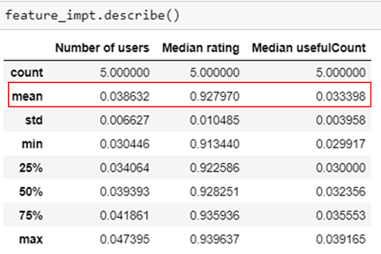
Determine Overall Score of Each Drug to Recommend to Patients
Results
In order of importance:
Median rating > Number of users > Median Useful Count
Notes:
After running the ExtraTreesClassifier a few times, the overall results show that the median rating has the highest mean importance, followed by Number of users and Median Useful Count.
We then used the mean importance of these features as the weightages found in our equation that is previously mentioned to calculate the overall score for each drug. This score is then used in our drug recommender system.

Slide 38
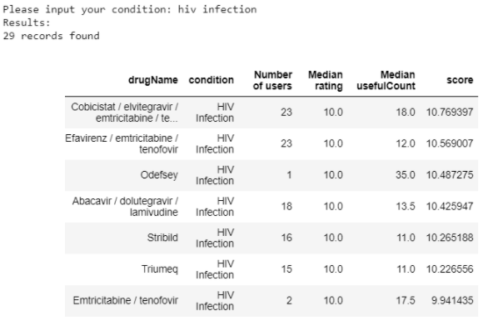
Determine Overall Score of Each Drug to Recommend to Patients
Drug Recommender System
Users are required to manually type in their condition
Results of all drugs available for that condition will be returned
Overall score arranged in descending order.
*Higher overall score = more suitable drug
Notes:
For our Drug Recommender System, users are required to manually type in their condition and the results of all the drugs available for that particular condition will be returned, with the overall score arranged in descending order. Higher overall score means that the specific drug is more suitable for that condition based on the 3 features.

Slide 39

06
Future Work

Slide 40
Cross Validation
Use cross-validation to evaluate our models
To flag problems such as overfitting since it reserves a sample of the dataset and trains the model using the remaining dataset
Not done due to time constraints.
Notes:
As taught in Week 5’s lesson, we are aware that we can use cross-validation to evaluate our final model. It is good to perform cross-validation as it is able to flag problems such as overfitting since it reserves a sample of the dataset and trains the model using the remaining dataset. However, this was not done due to time constraints.

Slide 41
SMOTE
Final results show that we have an imbalance of positive and negative sentiments.
Used macro average F1-score to choose best performing model
After doing further research, Synthetic Minority Oversampling Technique (SMOTE) can be used to tackle imbalance data.
Not done due to time constraints
Notes:
Our final results show that we have an imbalance of positive and negative sentiments. We have various performance measures such as precision, recall, F1-score, support and accuracy to evaluate our model and we decided to use the macro F1-score to choose the best performing model. However, after doing further research, we realised that we can use Synthetic Minority Oversampling Technique (SMOTE) to tackle the imbalance data. This was however not done due to time constraints as well.

Slide 42
References
https://towardsdatascience.com/sentimental-analysis-using-vader-a3415fef7664
https://machinelearningmastery.com/extra-trees-ensemble-with-python/#:~:text=Unlike%20random%20forest%2C%20which%20uses,a%20split%20point%20at%20random.&text=The%20random%20selection%20of%20split,the%20variance%20of%20the%20algorithm
https://www.mwsug.org/proceedings/2019/IN/MWSUG-2019-IN-064.pdf
https://www.theanalysisfactor.com/assessing-the-fit-of-regression-models/
https://archive.ics.uci.edu/ml/datasets/Drug+Review+Dataset+%28Drugs.com%29
https://monkeylearn.com/blog/what-is-tf-idf/
https://www.researchgate.net/publication/343064584_Disease_Prediction_and_Drug_Recommendation_Android_Application_using_Data_Mining_Virtual_Doctor
https://towardsdatascience.com/sentiment-analysis-vader-or-textblob-ff25514ac540

Slide 43
Thank you

